Slide 1


Daniel Gomez
10/23/21

Slide 2

Outline
Executive Summary
Introduction
Methodology
Results
Conclusion
Appendix

Slide 3
Executive Summary
Summary of methodologies
Data Collection and data wrangling
EDA and interactive visual analytics
Predictive analysis
Summary of all results
EDA with Visualization
EDA with SQL
Interactive map with Folium
Plotly Dash dashboard
Predictive analysis (classification)

Slide 4
Introduction
Project Background and Context
SpaceX advertises Falcon 9 rocket launches on its website with a cost of 62 million dollars; other providers cost upwards of 165 million dollars each, much of the savings is because SpaceX can reuse the first stage. Therefore, if we can determine if the first stage will land, we can determine the cost of a launch. This information can be used for SpaceY which is an alternate company that wants to compete with SpaceX.
Problems to be solved
What determines whether a rocket lands successfully or not?
What variables determine a rockets success rate?
What conditions must be met to achieve the best results for a successful landing?

Slide 5


Slide 6
Methodology
Executive Summary
Data collection methodology:
Web Scrapping
SpaceX Rest API
Perform data wrangling
Dropping unnecessary data and hot encoding data fields for machine learning
Perform exploratory data analysis (EDA) using visualization and SQL
Perform interactive visual analytics using Folium and Plotly Dash
Perform predictive analysis using classification models
How to build, tune, evaluate classification models

Slide 7
Data Collection
Datasets were collected by:
Working with the provided SpaceX launch data from the SpaceX Rest API
Data includes information on the rocket used, payload delivered, launch specifications, and landing outcomes
The data allows for the successful prediction on whether SpaceX will attempt to land a rocket.
Web scraping
HTML Response from website
Data extraction using beautiful soup
Data is normalized into a flat data file such as .csv
SpaceX API
Web Scraping
SpaceX Rest API
API Returns SpaceX data in .JSON file format
Data is normalized into a flat data file such as .csv

Slide 8
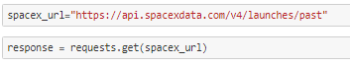
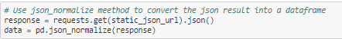
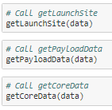
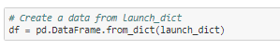
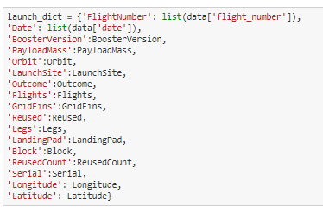
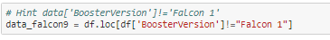
Data Collection – SpaceX API
1. Get Response from API
2. Convert Response to a .Json file
3. Clean Data
5. Assign Dictionary to Database
4. Assign List to Dictionary
6. Filter Dataframe
7. Export to .csv
GitHub URL to Notebook

Slide 9

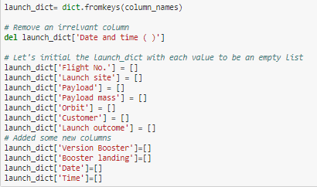
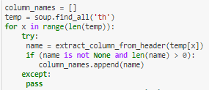
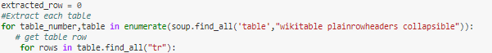
Data Collection - Scraping
Get HTML Response
5. Create a Dictionary
2. Create Beautiful Soup Object
3. Find Tables
4. Get Column Names
6. Append Data
7. Convert Dictionary to Dataframe
8. Convert to .csv
Github URL to Notebook

Slide 10
Data Wrangling
Exploratory Data Analysis (EDA) on Dataset
Number of launches at each site calculated
Number and occurrence of mission outcome per orbit type calculated
Dataset exported as .CSV
Number and occurrence of each orbit calculated
Landing outcome label from outcome column created
Success rate for every landing in dataset determined
Process
Github Link to Notebook

Slide 11
EDA with Data Visualization
Scatter graphs, a bar graph, and a Line graph were all used.
Scatter plots usually contain large amounts of data and are used to show how much one variable is affected by another.
The following scatter plots were used:
Flight Number vs. Payload Mass
Flight Number vs. Launch Site
Payload vs. Launch Site
Orbit vs. Flight Number
Payload vs. Orbit Type
Orbit vs. Payload Mass
Line Graphs were used to show trends and to make predictions with the available data.
Mean vs. Orbit bar graph was used
A bar Graph was used to compare different groups together and to show any big changes in data over time.
Success Rate vs. Year line graph was used
Github Link to Notebook

Slide 12
EDA with SQL
SQL Queries Performed:
Displaying names of unique launch sites
Displaying 5 records with specific launch site strings such as ‘KSC’
Displaying total payload mass by specific boosters
Displaying average payload mass carried by booster version
Listing Dates of successful landing outcomes
Listing the names of boosters with success in ground pad and payload masses between 4000 and 6000
Listing the total number of successful or failure mission outcomes
Listing the names of the booster versions that have carried the maximum payload mass
Listing records that display month names, successful landing outcomes in ground pad, booster versions, and launch site for the months in the year 2017
Ranking the successful landing outcomes between 2010-06-04 and 2017-03-20 in descending order.
Github Link to Notebook

Slide 13
Build an Interactive Map with Folium
Lines were used to visualize the latitude and longitude coordinates of launch sites, highways, coastlines, and cities. Circles were used to represent the launch sites.
Red and green markers were used to represent failure launch outcomes and successful launch outcomes respectively.
No launch sites were found to be in close proximity of railways, highways, and cities but they were found to be within close proximity from cities.
Github Link to Notebook

Slide 14
Build a Dashboard with Plotly Dash
A pie chart was added to the dashboard.
Pie chart showed the total launches for specific launch sites and for all launch sites.
Displayed multiple classes of data
A pie chart was chosen as a good visual representation of total quantity of a specific data set compared to others.
A scatter plot was added to the dashboard
A scatter plot was used to show the relationship between outcome and payload mass for different booster versions.
Best method to show non linear patterns
Maximum and minimums can easily be determined
Observation are straightforward
Github Link to source code

Slide 15
Predictive Analysis (Classification)
Model Building
Dataset was loaded into NumPy and Pandas
Data was transformed
Data was split into training and test data sets
Amount of sample tests was checked
Decision on what machine learning algorithms should be used
Parameters and algorithms were set to GridSearchCV
Datasets were set into GridSearchCV objects and dataset was trained
Model Evaluation
Accuracy was checked for each model
Hyperparameter were tuned for each algorithm type
Confusion matrix were plotted
Model Improving
Feature engineering and Algorithm tuning
Best Performing classification model
Model with the best accuracy score won as the best performing model
A dictionary of algorithms with scores can be found in the notebook
Github Link to Notebook

Slide 16
Results
Exploratory data analysis results
Interactive analytics demo in screenshots
Predictive analysis results

Slide 17


Slide 18
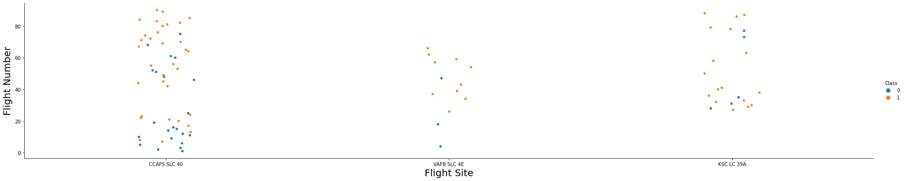
Flight Number vs. Launch Site
The greater the amount of flights at a launch site, the greater the success rate at a launch site.

Slide 19
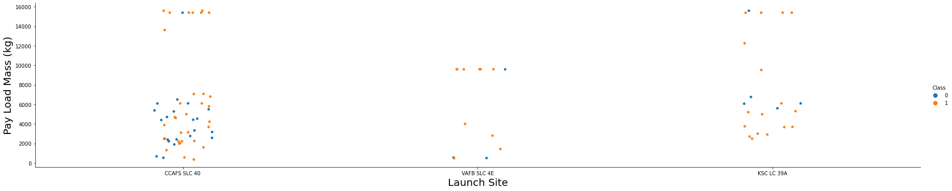
Payload vs. Launch Site
The higher the payload mass, the more successful the launches are. There are no heavy payload launches at the VAFB SLC4E Launchsite.

Slide 20
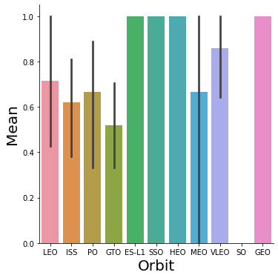
Success Rate vs. Orbit Type
Orbits GEO, HEO, SSO, and ES-LI have the highest success rates.

Slide 21
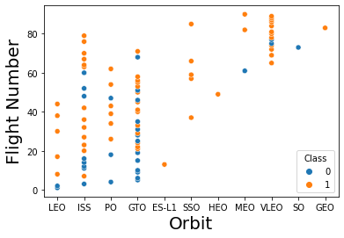
Flight Number vs. Orbit Type
In the LEO Orbit, the higher flight numbers are successful.
The GTO and ISS orbits have a lower success rate.
ES-LI and HEO only had one flight each. Both were successful.
The VLEO orbit had the highest success rate.

Slide 22
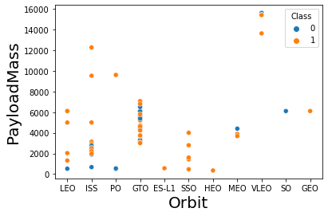
Payload vs. Orbit Type
Heavy payloads are less common in each orbit.
The GTO orbit maintains its payloads between 2000 and 8000.
The ISS and PO and VLEO orbits all have seen payloads greater than 8000 and all have a high success rate.

Slide 23
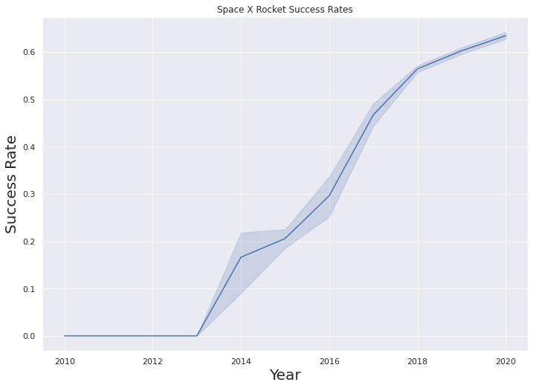
Launch Success Yearly Trend
The line graph shows an upward trend in the success rate starting from 2013.

Slide 24
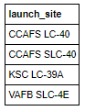
All Launch Site Names
SQL Query
Select DISTINCT Launch_Site from SPACEXTBL
Explanation of Query
Using DISTINCT guarantees that only unique values in the launch_site column within SPACEXTBL are chosen.

Slide 25
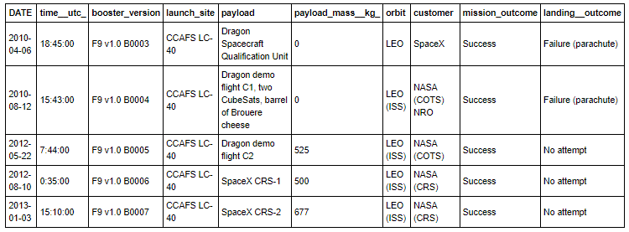
Launch Site Names Begin with 'CCA'
SQL Query
Select * from SPACEXTBL WHERE Launch_Site LIKE ‘CCA%’ LIMIT 5
Explanation of Query
Using WHERE will select the Launch_Site column and LIKE will select only names that begin with “CCA”. LIMIT 5 will select the top 5 results.

Slide 26
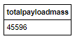
Total Payload Mass
SQL Query
Select SUM(PAYLOAD_MASS__KG_) TotalPayloadMass from SPACEXTBL where customer = ‘Nasa (CRS)’
Explanation of Query
SUM adds all payload mass kg values from the SPACEXTBL table were the customer is ‘NASA (CRS)’

Slide 27
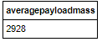
Average Payload Mass by F9 v1.1
SQL Query
Select AVG(PAYLOAD_MASS__KG_) AveragePayloadMass from SPACEXTBL where Booster_Version = ‘F9 v1.1’
Explanation of Query
AVG takes the average of the Payload mass kg column from the SPACEXTBL table where the booster version is ‘F9 v1.1’

Slide 28
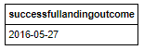
First Successful Ground Landing Date
SQL Query
Select MIN(Date) SuccessfulLandingOutcome from SPACEXTBL where Landing__Outcome = ‘Success (drone ship)’
MIN selects the minimum date value from SPACEXTBL table where the Landing Outcome is a success for a drone ship.

Slide 29
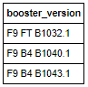
Successful Drone Ship Landing with Payload between 4000 and 6000
SQL Query
Select Booster_Version from SPACEXTBL where Landing__Outcome = ‘Success (ground pad)’ AND Payload_MASS__KG_ > 4000 AND Payload_MASS__KG_ < 6000
Explanation of Query
The booster version column is viewed in the SPACEXTBL table where the Landing outcomes are success (ground pad). AND includes only payload mass kg that falls between 4000 and 6000

Slide 30
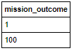
Total Number of Successful and Failure Mission Outcomes
SQL Query
Select COUNT(Mission_Outcome) as Mission_Outcome from SPACEXTBL where Mission_Outcome Like ‘Failure%’ UNION select COUNT(Mission_Outcome) from SPACEXTBL where Mission_Outcome Like ‘Success%’
Explanation of Query
COUNT counts the mission outcome from the SPACEXTBL table where there are both failures and success. UNION combines both queries. 1 failure and 100 successful missions.

Slide 31
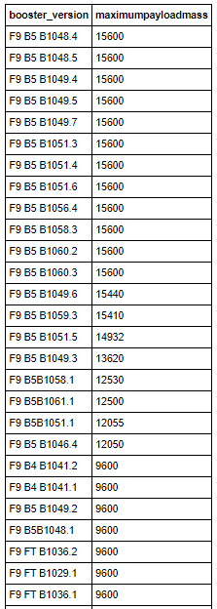
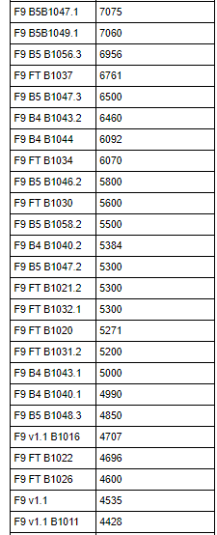
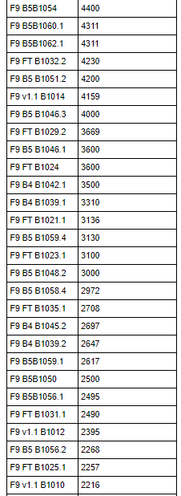
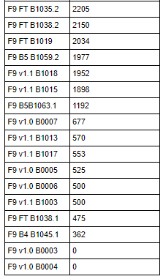
Boosters Carried Maximum Payload
SQL Query
Select DISTINCT Booster_Version, MAX(PAYLOAD_MASS__KG_) AS MaximumPayloadMass FROM SPACEXTBL GROUP BY Booster_Version ORDER BY MaximumPayloadMass DESC
Explanation of Query
DISTINCT selects only unique values. MAX selects the maximum payload mass from SPACEXTBL. GROUP BY groups the data by booster version and DESC orders the data in descending order.

Slide 32
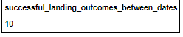
Rank Landing Outcomes Between 2010-06-04 and 2017-03-20
SQL Query
Select COUNT(Landing__Outcome) AS Successful_Landing_Outcomes_Between_Dates FROM SPACEXTBL WHERE (Landing__Outcome LIKE ‘Success%’) AND (Date>’2010-06-04’) AND (Date<‘2017-03-20’)
Explanation of Query
COUNT counts the landing outcomes. WHERE further filters results to only include success outcomes. AND further filters the data to only include data between the dates ‘2010-06-04 and ‘2017-03-20’

Slide 33


Slide 34

All SpaceX Launch Sites Global Map
All SpaceX Launch sites are in the U.S.A

Slide 35
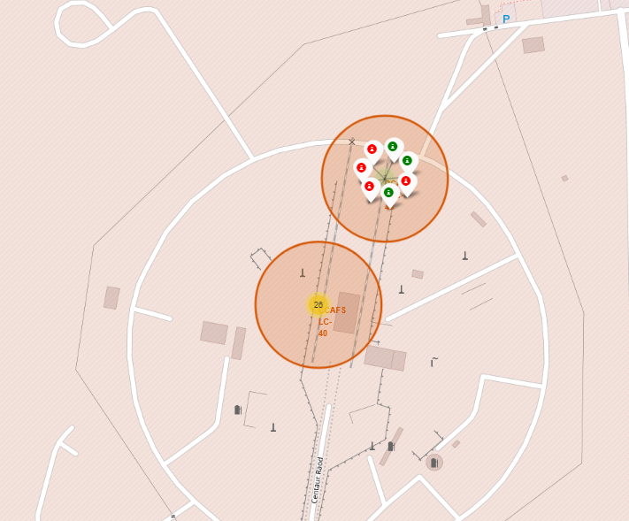
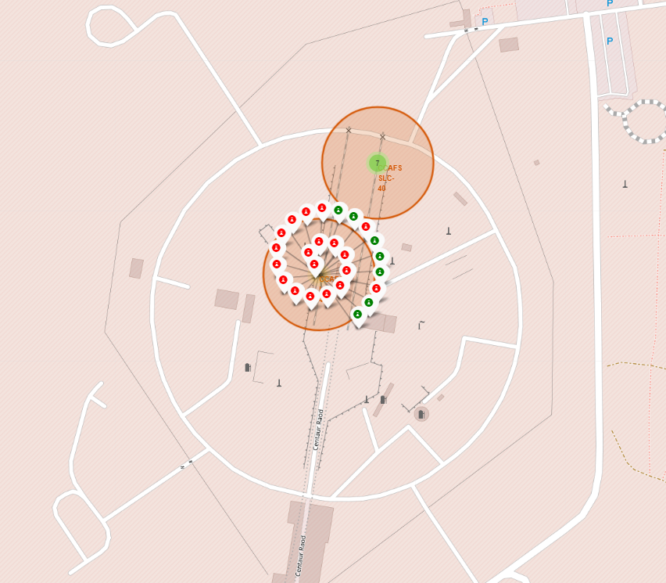
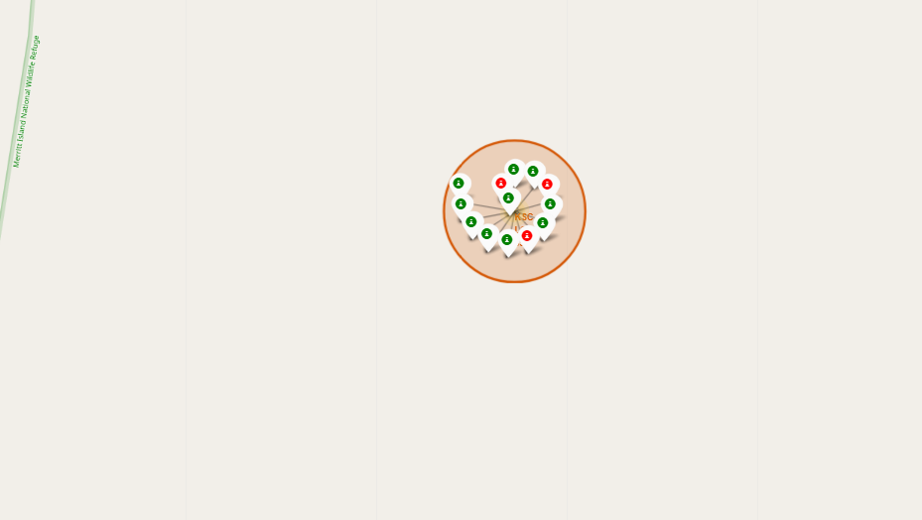
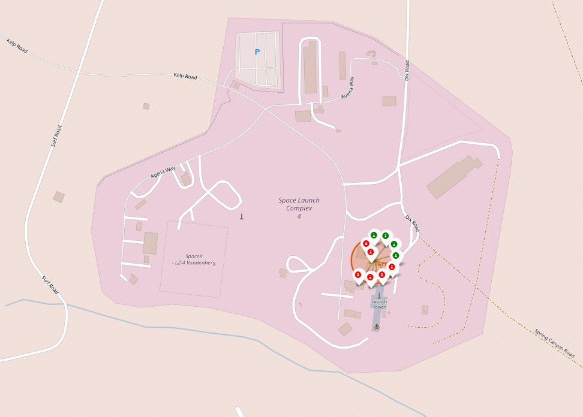
Color Labeled Launch Sites
Florida Launch Sites
The green markers show successful launches.
The red markers show unsuccessful launches.
There are 3 launch sites in Florida and 1 in California.
California Launch Site

Slide 36


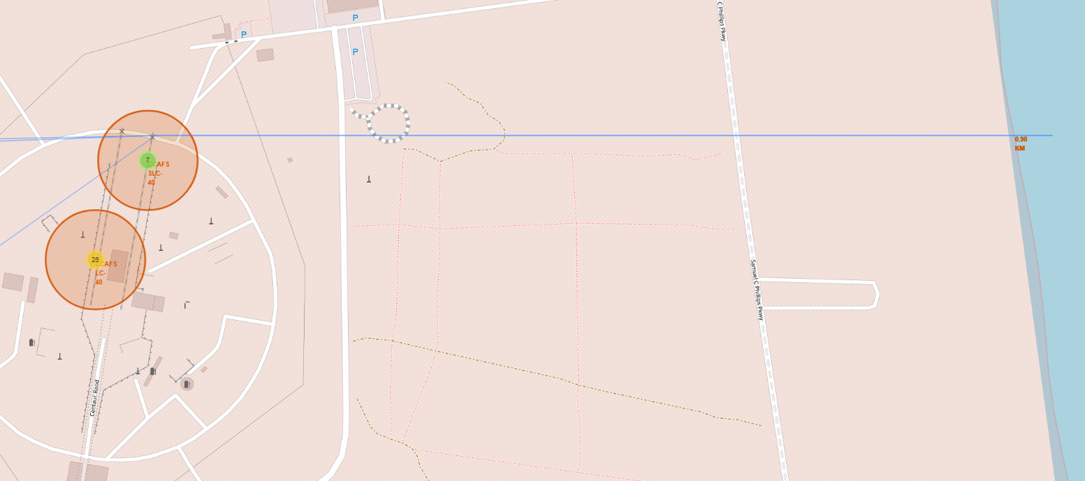
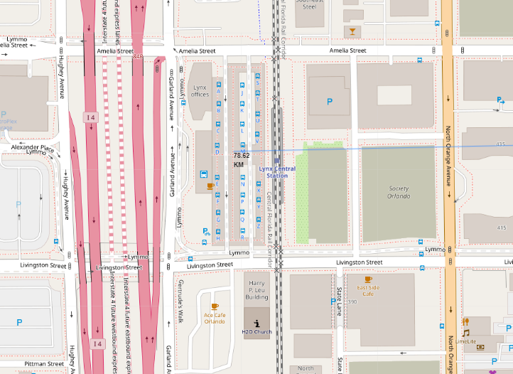
CCAFS SLC-40 Launch Site Distance from Landmarks
Distance to Highway
Distance to Florida City
Distance to Coastline
The launch site is not at a close distance to highways, cities, or railways but is close to the coastline.
Distance to Railway

Slide 37


Slide 38
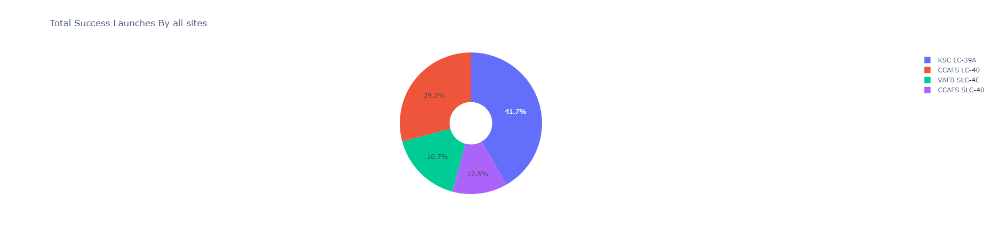
SpaceX Success Count for All Sites
The highest success rate belongs to launch site KSC LC-39A

Slide 39
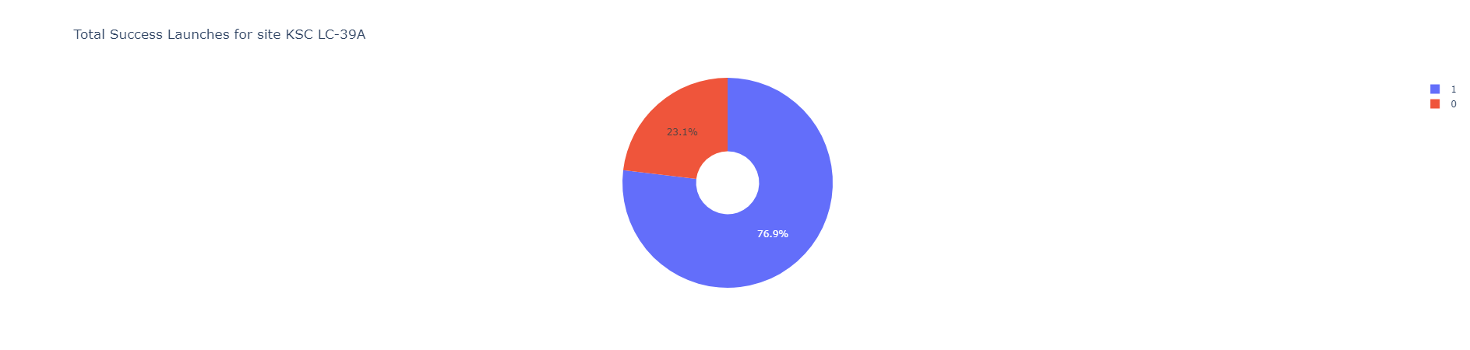
KSC LC-39 Launch Site
Site KSC LC-39A has the highest success ratio with only a 23.1% failure rate.

Slide 40
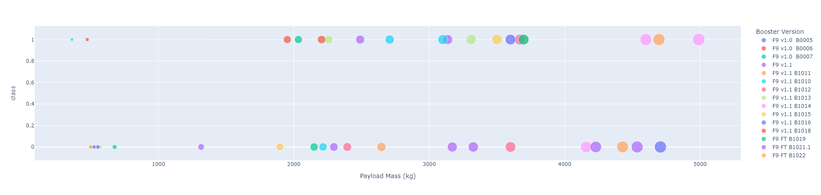
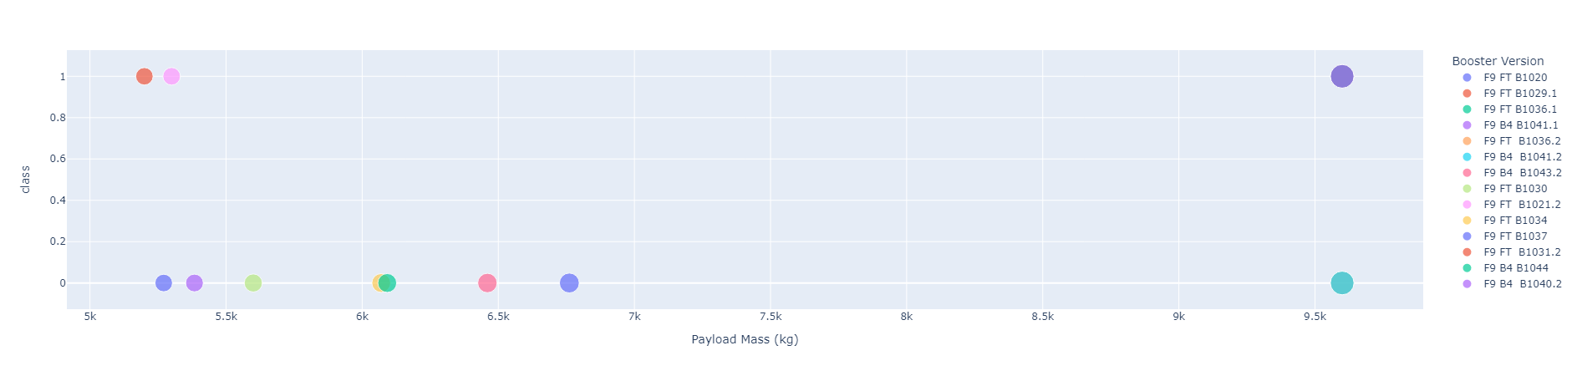
Scatter Plot Payload vs. Launch Outcome for all sites
Low Payload: 0kg-5000kg
The amount of launches in the low payload range are higher than the high payload range.
Higher payload has lower successful launches
F9 FT B1019 and F9 FT B1021.1 are the only booster versions that go above a payload of 8000kg
High Payload: 5000kg-10000kg

Slide 41


Slide 42
Classification Accuracy
Both the KNN and Logistic Regression accuracies are close. Within 0.0014 of each other.
The Tree algorithm has the best accuracy.

Slide 43
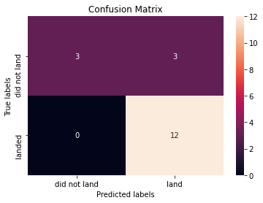
Confusion Matrix for the Tree Algorithm
The confusion matrix shows 12 true positives, 3 false negatives and 3 true negatives.

Slide 44
Conclusions
The Tree Algorithm performed best for this dataset for machine learning.
Low weighted payloads are less common but have a higher success rate.
The success rates for SpaceX launches increase throughout the years.
The GEO,HEO,SSO, and ES-L1 have the highest success rates.
KSC LC-39A is the site with the most successful launches.

Slide 45
Appendix
Include any relevant assets like Python code snippets, SQL queries, charts, Notebook outputs, or data sets that you may have created during this project

Slide 46


